Slide 1


Soutenance de Stage Alterné
Réaliser par : Mohammed Amine OUARRAKI
Tuteur : M. Taha CHELYAH
Année 2024/2025

Slide 2
Plan de présentation
01
02
03
04
05
06
07
Présentation d’Entreprise
Contexte
Choix Technologiques
Missions réalisées
Demonstration
Axes d’amelioration
conclusion

Slide 3
01
Présentation d’Entreprise

Slide 4

Accur Consulting
01
Cabinet de conseil en transformation digitale de la SupplyChain.
02
Digitalisation, l’automatisation et le pilotage des processus métiers.
03
Secteurs : Pharmaceutique, Cosmétique, Parfumerie…
04
Engagement RSE et sobriété numérique

Slide 5
02
Contexte

Slide 6
Contexte
Intégrer un ERP complet et personnalisé
Automatiser la migration des données avec Make
01
02
03
04
Personnalisation des factures avec BIRT
Développement de l’application Control Tower SupplyChain

Slide 7
03
Technologies

Slide 8





Technologies

Slide 9
04
Missions réalisées

Slide 10
Mission1: Déploiement d’Axelor sur GCP
Installation des prérequis techniques
Configuration d’une infrastructure sécurisée
Déploiement et tests de fonctionnement
Mise en place d’un démonstrateur ERP cloud
Rédaction d’une documentation technique complète

Slide 11
Mission2: Personnalisation des documents avec BIRT
Adaptation des modèles de factures d’Axelor
Utilisation de BIRT Designer (Eclipse)
Modification des fichiers .rptdesign
Ajout de champs dynamiques (client, TVA, montant total)
Tests et validation dans l’environnement ERP

Slide 12
Mission3: Automatisation avec Make
automatiser l’importation des fichiers Excel clients
Analyse des correspondances entre colonnes et champs ERP
Création de scénarios Make pour :
Lecture et nettoyage des données
Vérification des formats et suppression des doublons
Envoi automatique vers Axelor via API REST

Slide 13
Mission4: Application Control Tower SupplyChain
- Développement un outil de pilotage en temps réel de la performance la supplychain
- Optimiser la gestion des flux logistiques
- Identifier les points critiques
- Améliorer la prise de décision grâce à une --vision claire et dynamique
- Dashboard personnalisable avec widgets dynamiques(chart, tableaux,carte,map)

Slide 14
05
Demo

Slide 15


Slide 16
06
Axes d’Amelioration

Slide 17
Axes d’Amelioration
La mise en place complète du Backend for Frontend (FastAPI) pour mieux séparer les responsabilités
La migration de Supabase vers FastAPI, afin d’obtenir une architecture plus performante et maîtrisée
Création d’un module d’approvisionnement afin de gérer les demandes d’achat, commandes fournisseurs…
Enrichissement du dashboard avec de nouveaux KPIs et Optimisation de l’expérience utilisateur (UX/UI)

Slide 18
07
Conclusion

Slide 19
Merci Pour Votre Attention!

Slide 20
Contents of this template
You can delete this slide when you’re done editing the presentation
Axelor | To view this template correctly in PowerPoint, download and install the fonts we used
Birt | An assortment of graphic resources that are suitable for use in this presentation
Thanks slide | You must keep it so that proper credits for our design are given
Colors | All the colors used in this presentation
Icons and infographic resources | These can be used in the template, and their size and color can be edited
Editable presentation theme | You can edit the master slides easily. For more info, click here
For more info: Slidesgo | Blog | FAQs
You can visit our sister projects: Freepik | Flaticon | Storyset | Wepik | Videvo

Slide 21
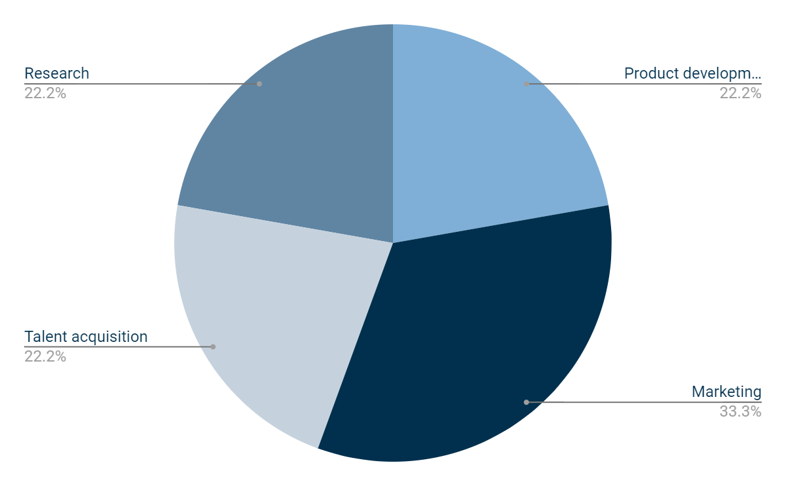
Budget for this quarter
$1,000,000,000
$998,300,000
$1,500,000,000
$1,000,000,000
Product development
Talent acquisition
Marketing
Research
Follow the link in the graph to modify its data and then paste the new one here. For more info, click here

Slide 22
Revenue information
 | Q1 | Q2 | Q3 | Q4 | Total
Product sales | $50,000 | $60,000 | $75,000 | $90,000 | $275,000
Labor | $20,000 | $24,000 | $30,000 | $36,000 | $110,000
Salaries | $15,000 | $18,000 | $20,000 | $24,000 | $77,000
Marketing | $7,000 | $8,000 | $9,000 | $10,000 | $34,000
Net income | $24,500 | $26,750 | $28,000 | $34,250 | $113,500
Rent | $5,000 | $5,000 | $5,000 | $5,000 | $20,000
Utilities | $1,500 | $1,750 | $2,000 | $2,250 | $7,500

Slide 23

Mockup
A mockup provides a visual representation of your product or service, allowing investors or stakeholders to better understand what you're offering and how it works

Slide 24
Canvas infographics
Key partners | Key activities | Value propositions |  | Customer relationships | Customer segments
Identify important partners for your business | Identify key activities that create value for customers | Define what sets your business apart from competitors |  | Determine how you will interact with customers | Define specific target customer groups
 | Key resources |  |  | Channels
 | Identify important resources needed for your business |  |  | Determine how you will reach and engage with customers
Cost structure |  |  | Revenue streams
Identify fixed and variable costs associated with the business |  |  | Define sources of revenue for your business

Slide 25
My business strategy
Attractive business model
Growth and expansion strategy
Reorientation or abandonment strategy
High competitive strength
Low competitive strength
Maintenance and protection strategy
Reduction or elimination strategy
Unattractive business model

Slide 26
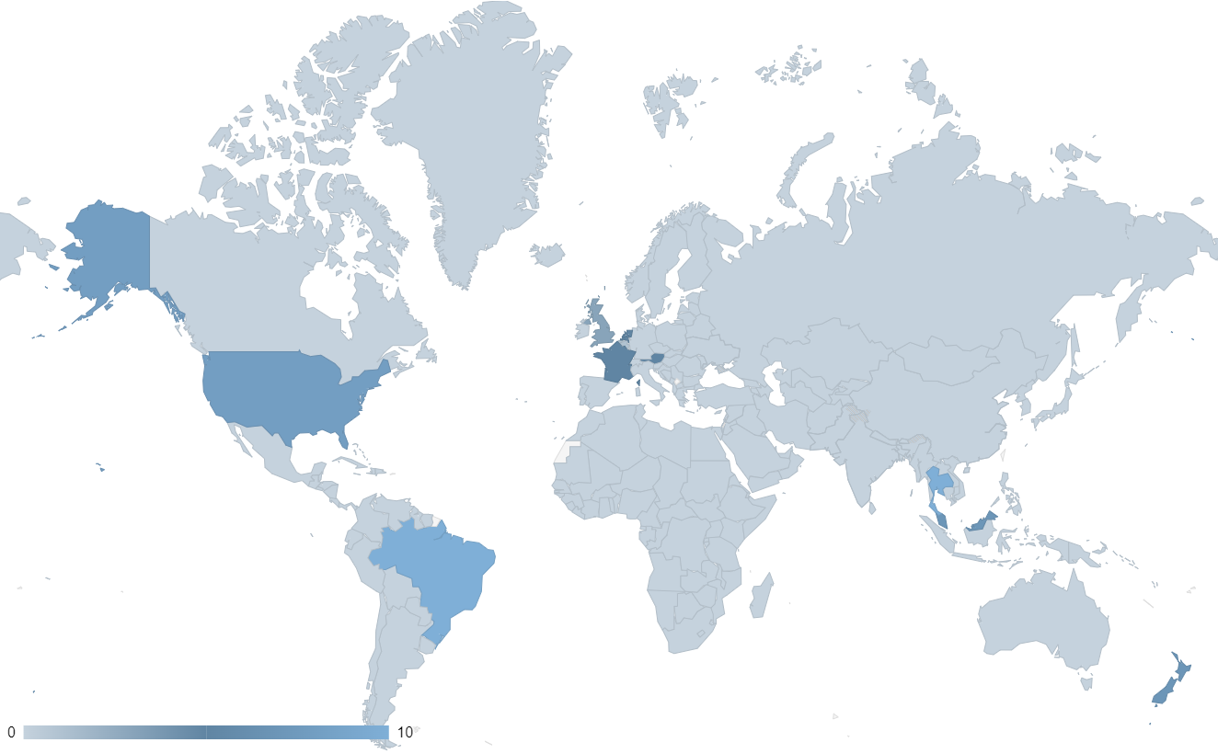
Target infographics
Demographics
Locations
Behavior
Age
20-60 years old
They may be interested in personal and professional development, as they are both employees and students
They may be tech-savvy and use technology to streamline their work and personal life
They may be people who are in any family situation, whether single or married, with children or not
Gender
Male and female
Occupation
Employees
and students
Family situation
Single and married people
Region
Various
Income
$70,000/year
Area
Urban
Follow the link in the map to modify its data and then paste the new one here. For more info, click here

Slide 27
Organizational chart
CEO
CTO
CFO
Director of IT
Director of HR
Controller
Treasurer
Systems administrator
IT manager
Accounting manager
Financial analyst
Accounts payable

Slide 28
Market size infographics
$100M
$20M
$5M
"With the innovative approach and unique features, we aim to capture a significant portion of the $100 million"
"The research indicates that the market for [product/service] is projected to reach $20 million by next year"
"The market for [product/service] is currently valued at $5 million"

Slide 29
Alternative resources
Here’s an assortment of alternative resources whose style fits that of this template:
Vectors
Flat design instagram post design template

Slide 30
Resources
Did you like the resources on this template? Get them on our other websites:
Vectors
Church template design
Photos
Business people having fun
Blonde worker at desk

Slide 31
Instructions for use
If you have a free account, in order to use this template, you must credit Slidesgo by keeping the Thanks slide. Please refer to the next slide to read the instructions for premium users.
As a Free user, you are allowed to:
Modify this template.
Use it for both personal and commercial projects.
You are not allowed to:
Sublicense, sell or rent any of Slidesgo Content (or a modified version of Slidesgo Content).
Distribute Slidesgo Content unless it has been expressly authorized by Slidesgo.
Include Slidesgo Content in an online or offline database or file.
Offer Slidesgo templates (or modified versions of Slidesgo templates) for download.
Acquire the copyright of Slidesgo Content.
For more information about editing slides, please read our FAQs or visit our blog:
https://slidesgo.com/faqs and https://slidesgo.com/slidesgo-school

Slide 32
Instructions for use (premium users)
As a Premium user, you can use this template without attributing Slidesgo or keeping the Thanks slide.
You are allowed to:
Modify this template.
Use it for both personal and commercial purposes.
Hide or delete the “Thanks” slide and the mention to Slidesgo in the credits.
Share this template in an editable format with people who are not part of your team.
You are not allowed to:
Sublicense, sell or rent this Slidesgo Template (or a modified version of this Slidesgo Template).
Distribute this Slidesgo Template (or a modified version of this Slidesgo Template) or include it in a database or in any other product or service that offers downloadable images, icons or presentations that may be subject to distribution or resale.
Use any of the elements that are part of this Slidesgo Template in an isolated and separated way from this Template.
Register any of the elements that are part of this template as a trademark or logo, or register it as a work in an intellectual property registry or similar.
For more information about editing slides, please read our FAQs or visit our blog:
https://slidesgo.com/faqs and https://slidesgo.com/slidesgo-school

Slide 33
Fonts & colors used
This presentation has been made using the following fonts:
Ramabhadra
(https://fonts.google.com/specimen/Ramabhadra)
Source Sans 3
(https://fonts.google.com/specimen/Source+Sans+3)
#00304e
#ffffff
#7fafd7
#6085a3
#c5d2dd

Slide 34





Storyset
Create your Story with our illustrated concepts. Choose the style you like the most, edit its colors, pick the background and layers you want to show and bring them to life with the animator panel! It will boost your presentation. Check out how it works.
Pana
Amico
Bro
Rafiki
Cuate

Slide 35
Use our editable graphic resources...
You can easily resize these resources without losing quality. To change the color, just ungroup the resource and click on the object you want to change. Then, click on the paint bucket and select the color you want. Group the resource again when you’re done. You can also look for more infographics on Slidesgo.

Slide 38
JANUARY
FEBRUARY
MARCH
APRIL
MAY
JUNE
PHASE 1
Task 1
Task 2
PHASE 2
Task 1
Task 2
JANUARY
FEBRUARY
MARCH
APRIL
PHASE 1
Task 1
Task 2

Slide 41
...and our sets of editable icons
You can resize these icons without losing quality.
You can change the stroke and fill color; just select the icon and click on the paint bucket/pen.
In Google Slides, you can also use Flaticon’s extension, allowing you to customize and add even more icons.

Slide 42
Educational Icons
Medical Icons

Slide 43
Business Icons
Teamwork Icons

Slide 44
Help & Support Icons
Avatar Icons

Slide 45
Creative Process Icons
Performing Arts Icons

Slide 46
Nature Icons

Slide 47
SEO & Marketing Icons

Slide 48


